Slide 1
Neural Machine Translation For Indian Languages
A. Bhavishya (16WH1A1202)
B. Sandhya (16WH1A1210)
G. Divyalata (16WH1A1215)
V. Bhanu Samera(16WH1A1248)
Under the Guidance of:
L. Naveen Kumar
Assistant Professor

Slide 2
Contents
Introduction
Literature Survey
Problem Definition
Existing System
Proposed System
Architecture Diagram
Plan of Action
Modules
References

Slide 3
Introduction
Machine Translation
Sub branch of Natural Language Processing
Involves use of computers to translate from one language to another
Three major approaches
(i) Linguistic
(ii) Non-linguistic
(iii) Hybrid

Slide 4

1. Linguistic approach
Uses grammar and computer to translate a word from source language to target language
Direct method involves use of bilingual dictionaries to translate from source to target
Interlingua method involves two-step process: text is first translated to an “intermediate language” and then to the target language
Transfer method uses a large of database with translation rules is used

Slide 5
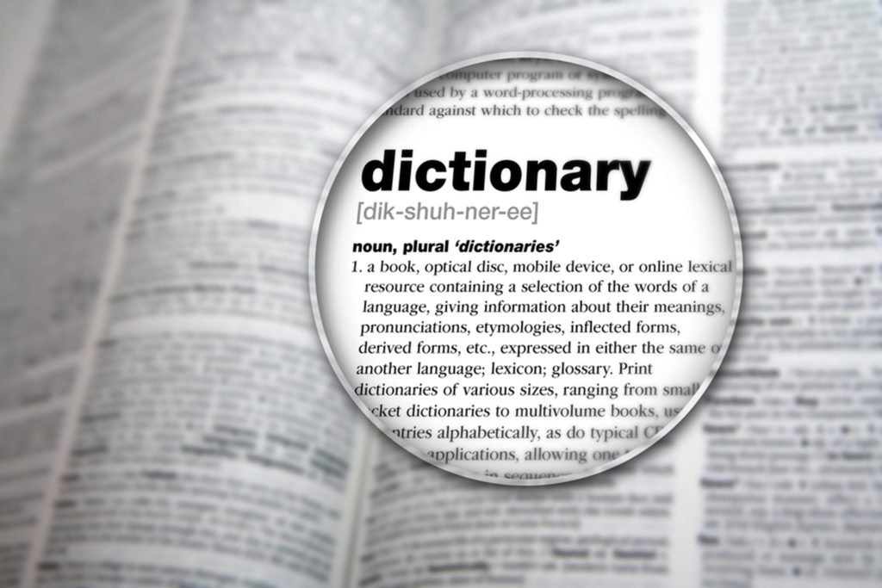
2. Non-linguistic approach
Dictionary method: Text is translated word by word from source to target language
Corpus-based method: System is “trained” by using mono- or bilingual corpus of target language
Example-based method: Translation problem is divided to sub problems; each sub problem is solved based on experience from solving previous problems
Statistical method: Estimate most probable model and apply it to translate

Slide 6

3. Hybrid approach
A combination of rule-based and statistical based translation systems
For instance, a rule-based system may be used to generate a base translation, followed by post-processing of it using statistical approach to select the most commonly used structure of text.

Slide 7

Limitations of MT
Limited scope: The above methods work well with only grammatically correct input text
Efficiency is in question: Translated text may or may not be in a form that is commonly understood by all
Because of the above limitations, we adopt Neural Machine Translation approach.

Slide 8
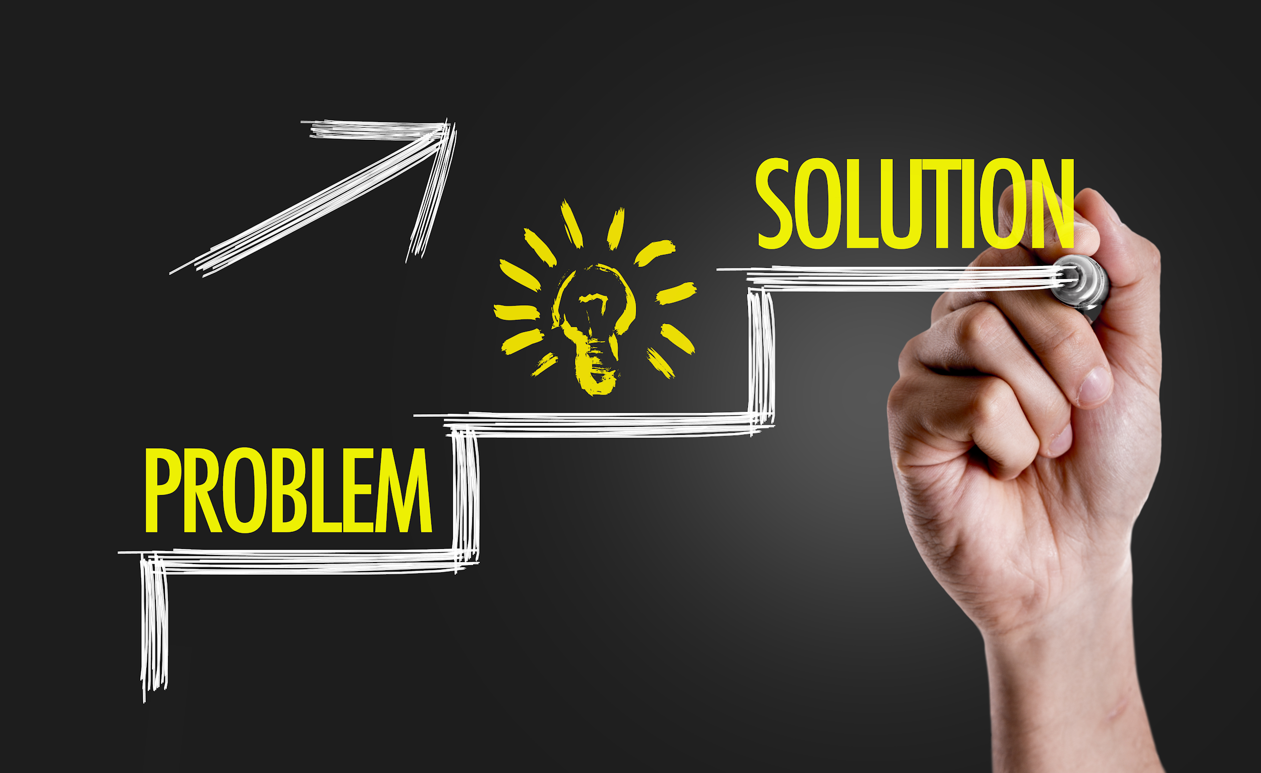
Problem statement
To create a technology tool to translate written text from English to Hindi

Slide 9
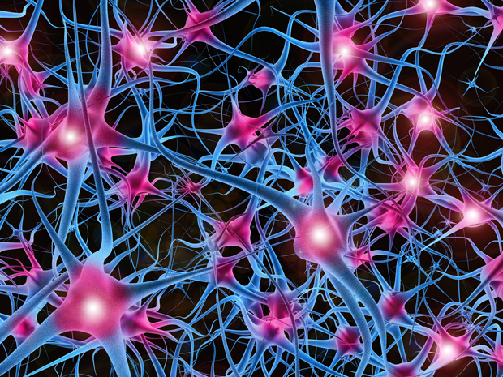
Methodology: Neural MT
Neural Machine Translation differs from rule-based and statistical systems in one important way
NMT system “learns” how to translate by itself -- by looking at the training data
This self-learning translation system is based on two key ideas
(i) Neural Network
(ii) Encoder - Decoder Model

Slide 10
1. Neural Network
A regular Neural Network is a generic machine learning algorithm
It takes in a list of numbers and calculates a result
If same set of numbers are given as input, the output will also be the same
However, in a Neural Network the previous results can change the results of future calculations

Slide 11
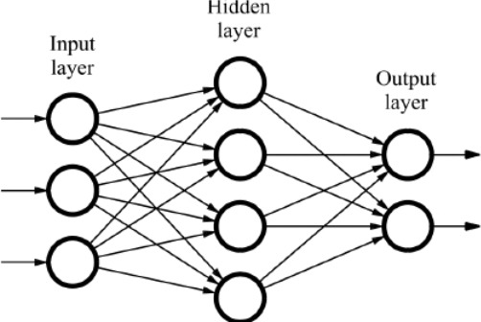
NN concept

Slide 12
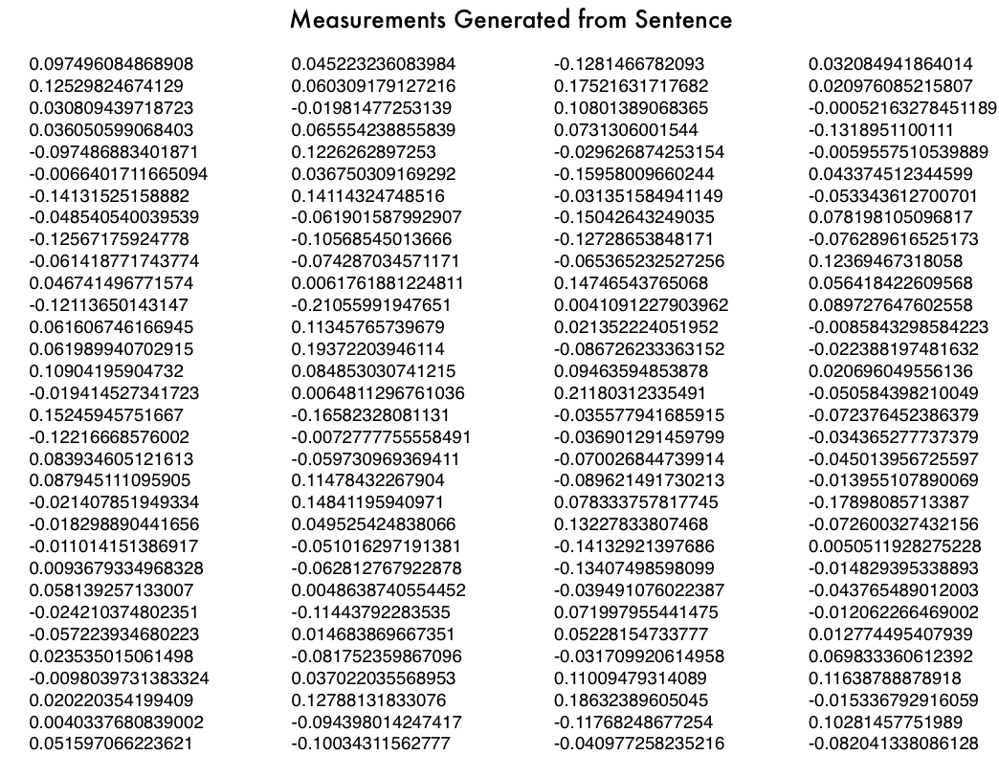
2. Encoder-Decoder Model
Encoding means generating ‘numbers’ for a given text input
Example: ----->
Input text
‘Machine learning is fun’

Slide 13
How encoder-decoder model works
This involves LSTMs, one each for encoder and decoder
Before the encoder step, the input sequences in source language (English) are turned into embedding vectors (i.e., a matrix of numbers) by a predefined class called ‘Embedding’
These embedding vectors become the input to encoder
The encoder turns these into fixed-dimension ‘state vectors’
After this step, the encoder gives out (i) a hidden state, and (ii) a cell state
These two states are fed into the decoder

Slide 14
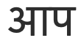
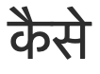

How encoder-decoder model works
The decoder LSTM takes the state vector given by the encoder as input
The decoder is trained to output the translation one word at a time
It also predicts the next words of the target sequence based on previously translated sequence
DECODER
ENCODER
How
are
you
EOS

Slide 15
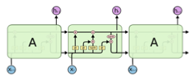
Long & Short Term Memory (LSTM): Proposed model
LSTM is a variation of RNN with four layers or ‘gates’
First gate -- ‘forget gate’ -- decides which part of previous learning should be forgotten
Second ‘sigmoid’ or input gate layer decides which values the system will update
Third ‘tanh’ layer creates a vector of possible values that could be added to the state in the same module
Finally, fourth ‘output’ layer decides result and the state for the next module

Slide 16
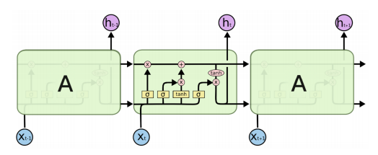
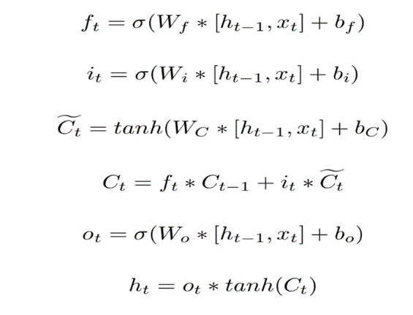
Working of LSTM

Slide 17
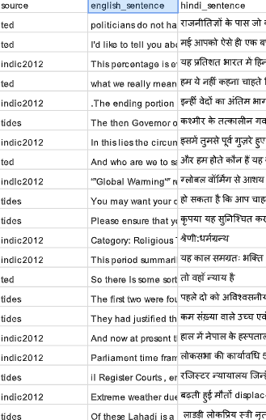
Other requirements
Dataset for source and target languages (1,27,608)
Google Colab

Slide 18
Modules
Data preprocessing
Tokenization and padding
Creating the model
Testing the model
Training the model

Slide 19
Data preprocessing
For a neural network to translate text, the input text to be turned into data
Since a neural network is a series of multiplication and addition operations, the input data needs to be number(s).
So, we will have to convert text into sequences of integers, using:
1. Tokenization
2. Padding

Slide 20
Tokenization
Tokenization is a process that splits an input sequence into several small chunks or tokens and useful for semantic processing.
Whitespace Tokenizer: defines whitespaces as the boundary between tokens.
‘Tokenizer function’ in Keras will generate word ids for the sequence of words.

Slide 21
Padding
Since input sentences are dynamic in length, we can add padding to the end of the sequences to make them the same length.
All the input and output sequences are adjusted to have the same length by adding padding to the end of each sequence using Keras's pad_sequences function.

Slide 22
Creating the model
In creating the model, the first thing we need to do is to define our output will be sequence of words.
In these we need to create encoder and decoder. The input to the encoder will be the source languages and output will be the hidden state & cell state of LSTM
Next step is to define the decoder, the decoder will take the 2 input i.e hidden state & cell state. This will be output the encoder
Next is to compile the model

Slide 23
Training the model
Train the model by the method fit
In steps, we converted words to integer the output from the decoder is integer, now will convert to the words

Slide 24
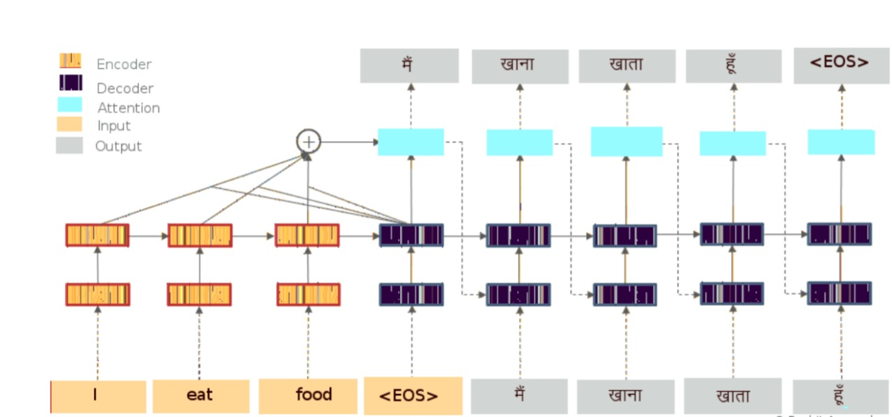
Training the model

Slide 25
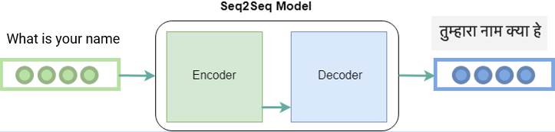
Testing the model

Slide 26
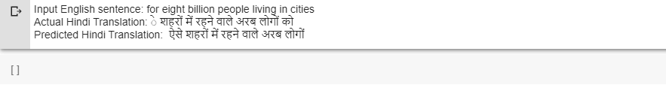
Output without Attention

Slide 27
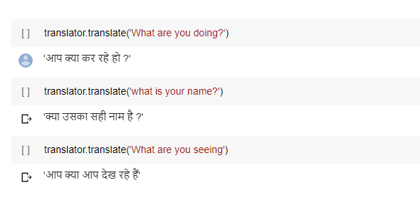
Output with Attention

Slide 28
Plan of Action
Module | Status | Time required
Literature Survey | Completed | --
Requirement Analysis | Completed | 1 week
Design | Completed | 2 weeks
Implementation | Completed | 4 weeks
Documentation | Completed | 1 week
Final Submission | Completed | --

Slide 29
References
1. Saini, Sandeep & Sahula, Vineet. (2018). Neural Machine Translation for English to Hindi. 1-6. 10.1109/INFRKM.2018.8464781.
2. Machine Learning is Fun Part 5: Language Translation with Deep Learning and the Magic of Sequences, by Adam Geitgey.
3. Machine Translation (MT) Techniques for Indian Languages by S. Anbukkarasi, Dr. S. Varadhaganapathy. International Journal of Recent Technology and Engineering (IJRTE). Volume-8 Issue-2S4, July 2019

Slide 30
Thank you

